Slide 1
Asthma Prediction Using Machine Learning
Sam Lee

Slide 2
Section
1. Introduction
2. Identify data
3. Exploratory Data Analysis (EDA)
4. Preprocessing
5. Feature selection
6. Models & Result

Slide 3
Introduction
Asthma is one of the chronic diseases affecting people of all ages
Which demographic and behavioral factors are most influential in predicting asthma prevalence, and how effectively can machine learning models identify it?
Dataset utilized in the project was generated in 2023, and includes state-specific data on health risk behaviors, chronic diseases, access to health care, etc.
From Behavioral Risk Factor Surveillance System (BRFSS) project under Centers for Disease Control and Prevention (CDC)

Slide 4
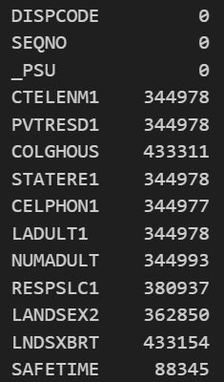
Data
433323 entries with 350 columns
Lots of entries with null values
Including various columns that are unnecessary for the project

Slide 5
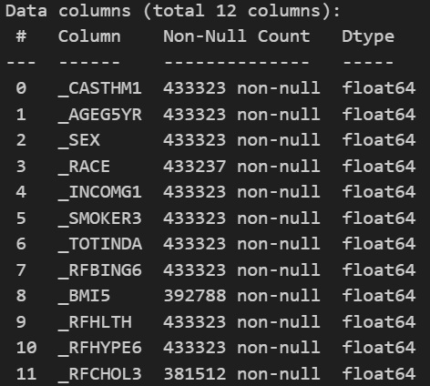
Data
_CASTHM1: Asthma prevalence, dependent variable
Behavioral Factors: SMOKER3, TOTINDA, RFBING6
Demographic Factors: AGE5YR, SEX, RACE, INCOMG1
Health Factors: BMI5, RFHLTH, RFHYPE6

Slide 6
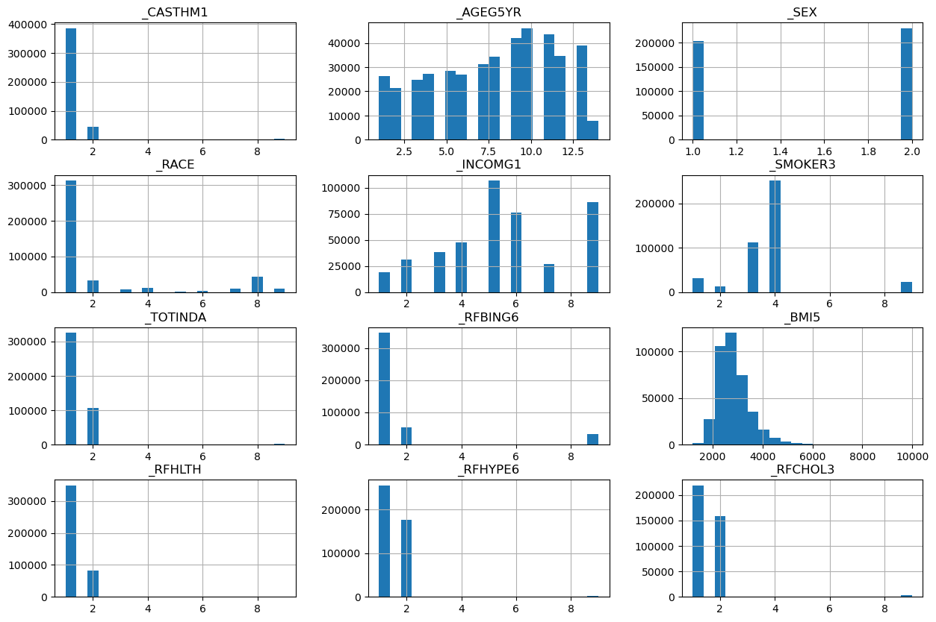
EDA
CASTHM1
-> 1: No Asthma / 2: Asthma
Sex
-> 1: Male / 2: Female
INCOMG1
-> Income range from $15,000 to $200,000
TOTINDA
-> 1: Exercise / 2: No Exerciase
RFBING6
-> 1: No Heavy Drinking / 2: Heavy Drinking
RFHYPE6
-> 1: Regular / 2: High Blood Pressure

Slide 7
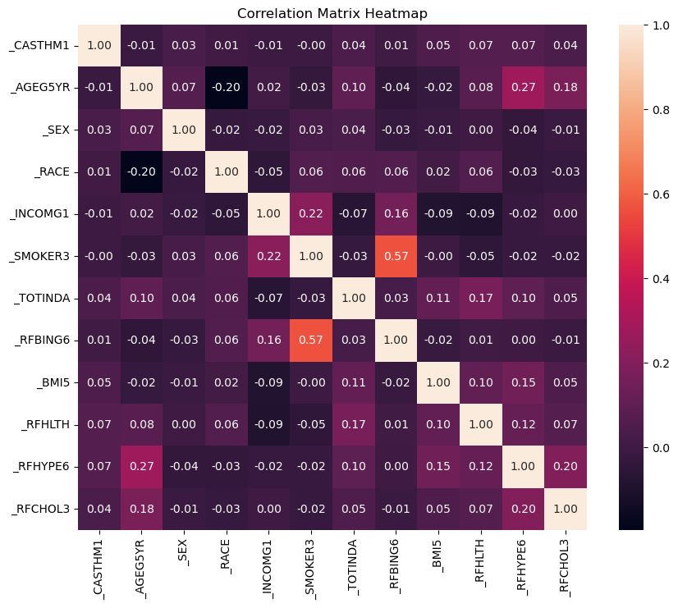
EDA
Most independent variables have “very weak” correlations with asthma prevalence.
Therefore, non-linear relationship was expected and set the approach based on this.

Slide 8
Preprocessing
Choose variables that have NaN and drop them
Encode categorical variables into numeric values for further machine learning
Normalize continuous variables
Split the dataset into training set and test set (7:3)

Slide 9
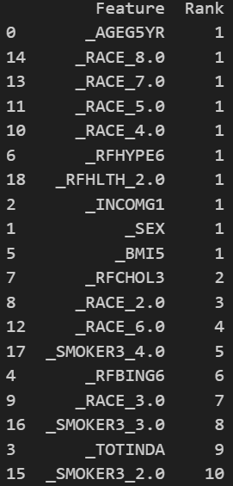
Feature Selection
Adopted Recursive Feature Elimination (RFE) to identify the significant variables for prediction
Even though few variables from initial selection have been excluded, it’s still valid to get the most significant predictors for machine learning

Slide 10
Models & Result
 | Logistic Regression before balancing |  | Logistic Regression after balancing |  | Random Forest |  | Decision Tree
class | No Asthma | Asthma | No Asthma | Asthma | No Asthma | Asthma | No Asthma | Asthma
precision | 0.89 | 0.56 | 0.93 | 0.17 | 0.90 | 0.14 | 0.90 | 0.13
recall | 1.00 | 0.00 | 0.66 | 0.58 | 0.89 | 0.15 | 0.82 | 0.23
f1-score | 0.94 | 0.01 | 0.77 | 0.26 | 0.89 | 0.14 | 0.86 | 0.15
AUC score | 0.66 |  | 0.66 |  | 0.56 |  | 0.52

Slide 11
Result
Overall, all the models got high precision for Non-asthma class but struggled with asthma class
Logistic regression method shows the highest AUC score of 0.66 which indicates moderate performance. However, Decision Tree shows the lowest AUC score of 0.52 which is almost close to random guessing
While those models provided insights into asthma risk factors, there were limitations due to class imbalance and potentially insufficient predictors
Future research might utilize BRFSS data from 2011 for sufficient number of samples, and put different target variables in order to compare the factors for various chronic diseases

